Slide 1






NUS SOC
SOC PROJECT
PRESENTATION
BY UNITY

Slide 2


Content
NUS SOC
1.
INTRODUCTION
AGENDA
ARCHITECTURE
2.
3.
HIGHLIGHT

Slide 3
INTRODUCTION
Our project involves creating a web application called EventEase.
EventEase is designed to help students book campus events seamlessly.
Features of EventEase:
Students can view their profiles.
View their booked events on personal calender.
Students can access detailed event information.

Slide 4
PROJECT DESCRIPTION
EventEase is an event booking system.
Designed to simplify and streamline the process of attending events.
Leverages Kubernetes for scalable and reliable deployment.

Slide 5
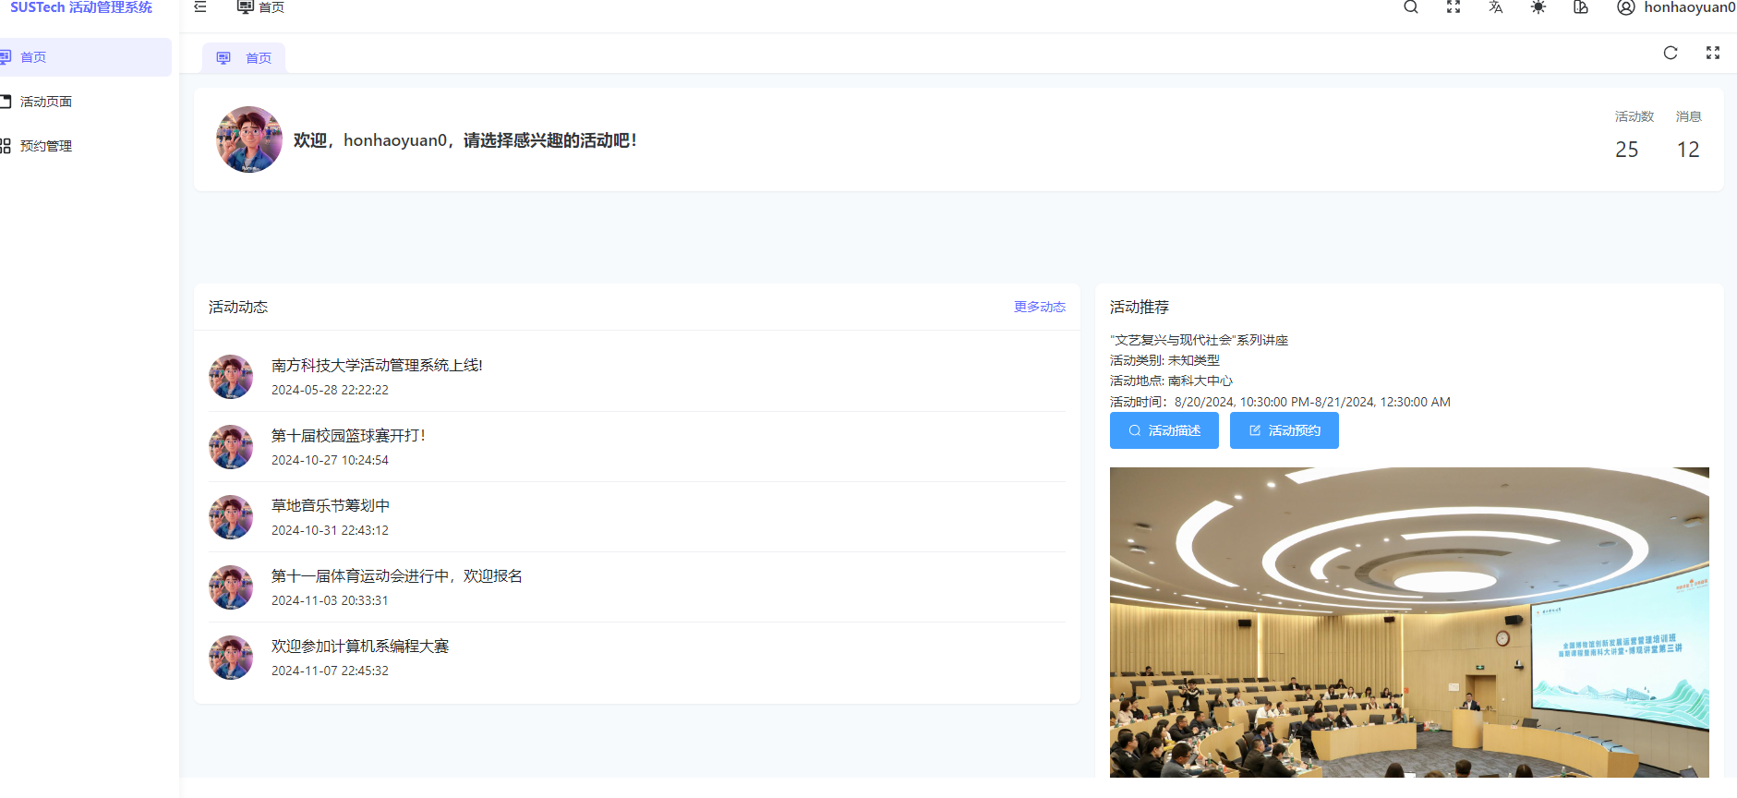

Slide 6
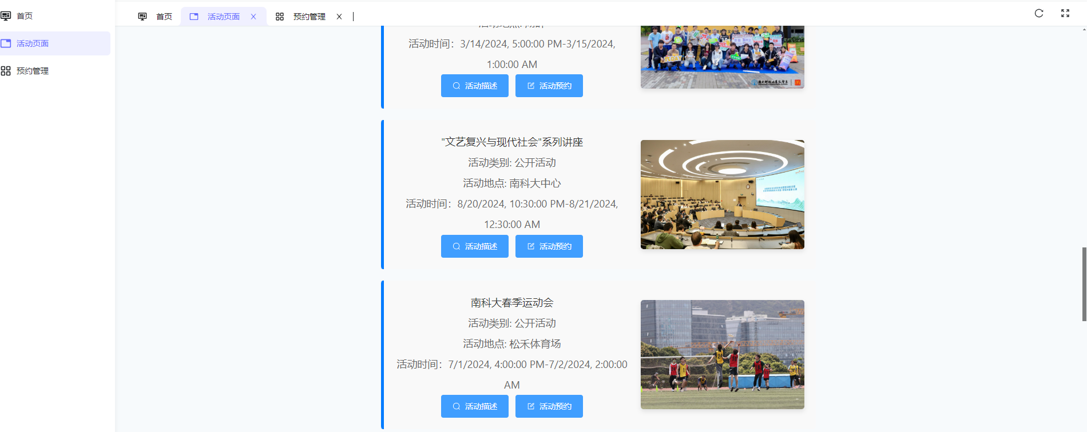

Slide 7
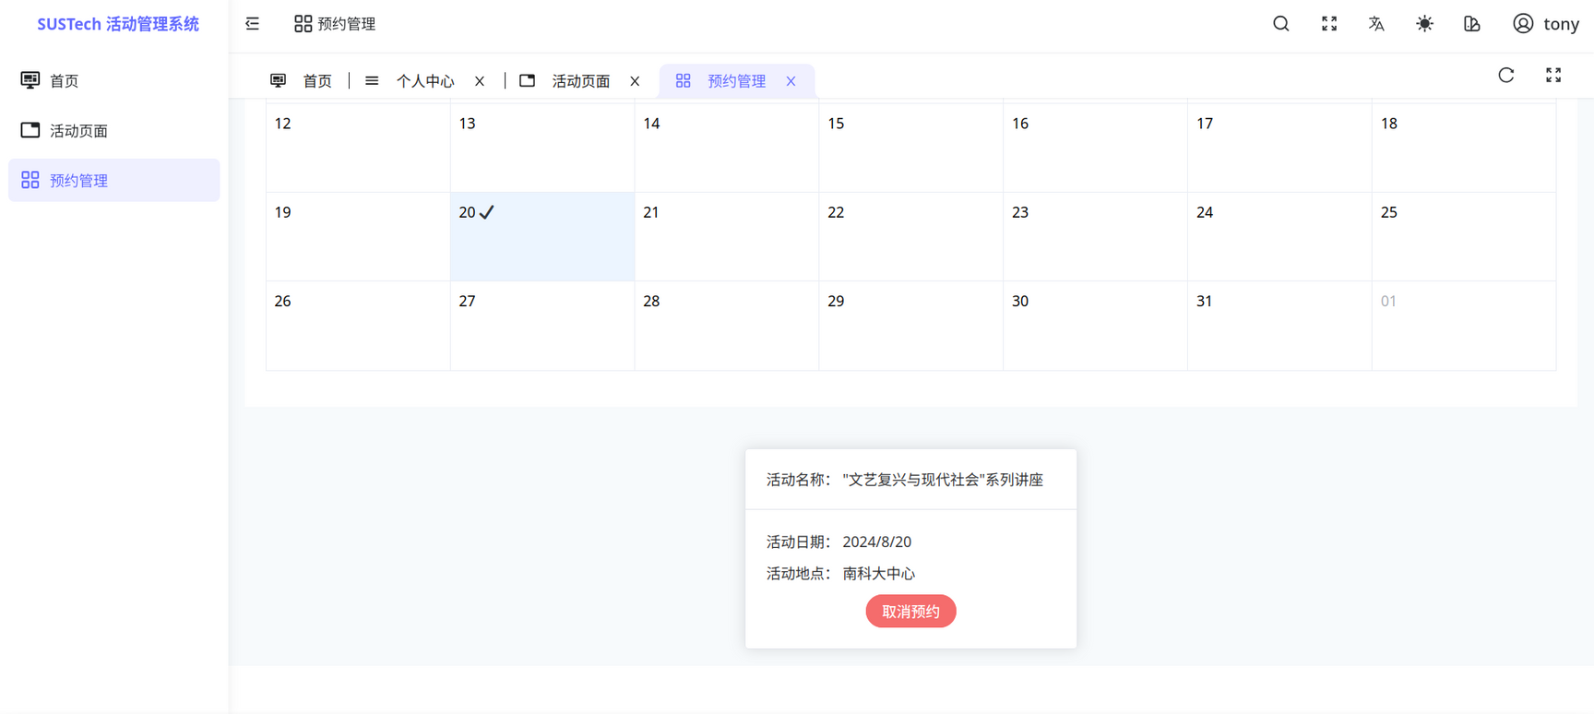

Slide 8
SYSTEM
ARCHITECTURE

Slide 9
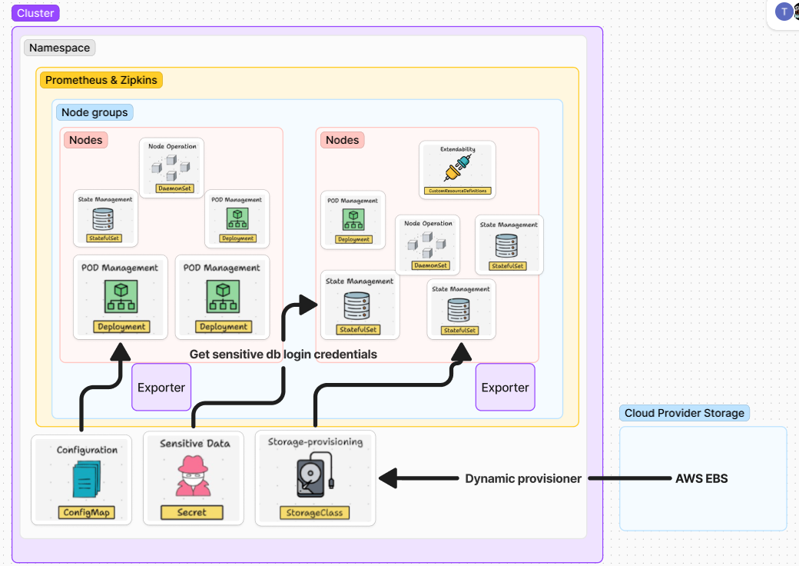
Overall System Architecture

Slide 10
KEY COMPONENT
Front-End: Deployed using a Kubernetes Deployment with a LoadBalancer service for public access.
Microservices: Includes auth, redis, main, user, and verify services, deployed using Kubernetes Deployments and StatefulSets for database management.
Monitoring and Logging: Utilizes Prometheus, Grafana, and Grafana Loki for metrics collection, visualization, and log aggregation.
Custom Operator: Ensures seamless synchronization of distributed databases for data consistency.
Tracing: Uses Zipkin for troubleshooting latency issues in services.

Slide 11
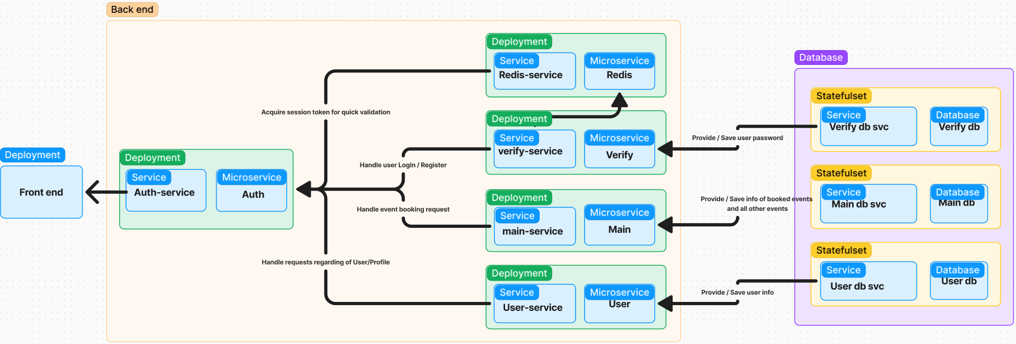
WEBAPP ARCHITECTURE

Slide 12
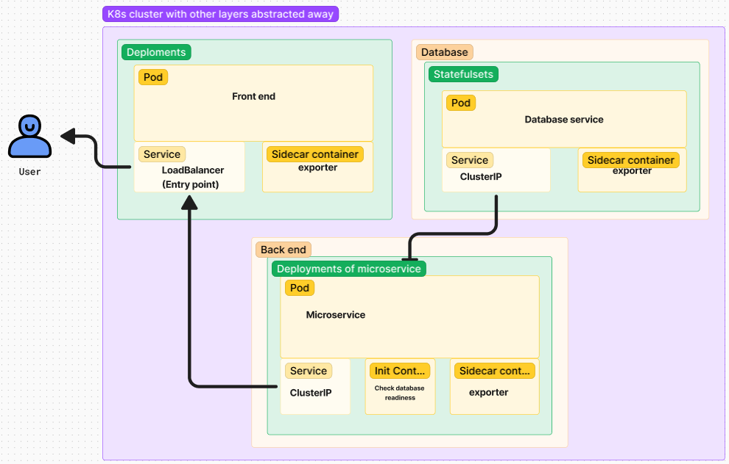
MICROSERVICE ARCHITECTURE

Slide 13

3. HIGH LIGHT
Our project extends a typical Kubernetes cloud-native application in three key areas.
A. Monitoring and Logging
B. Custom Operator
C. Zipkins

Slide 14

A. Monitoring and Logging Architecture overview

Slide 15
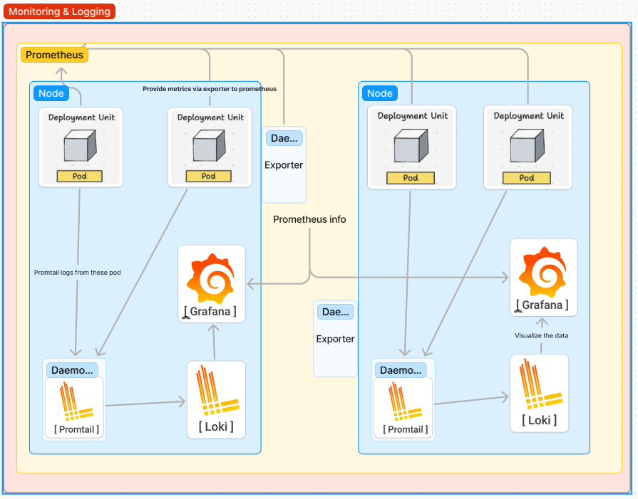

Slide 16
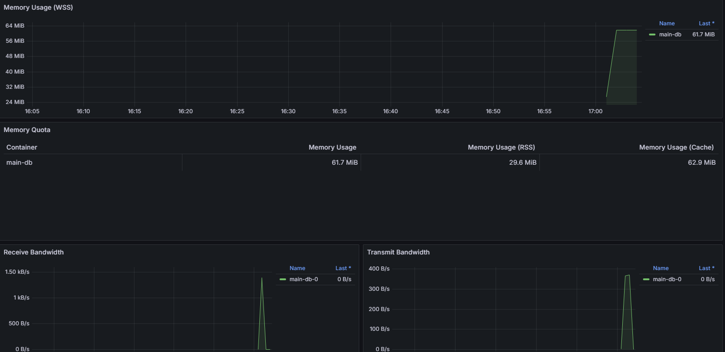

Slide 17
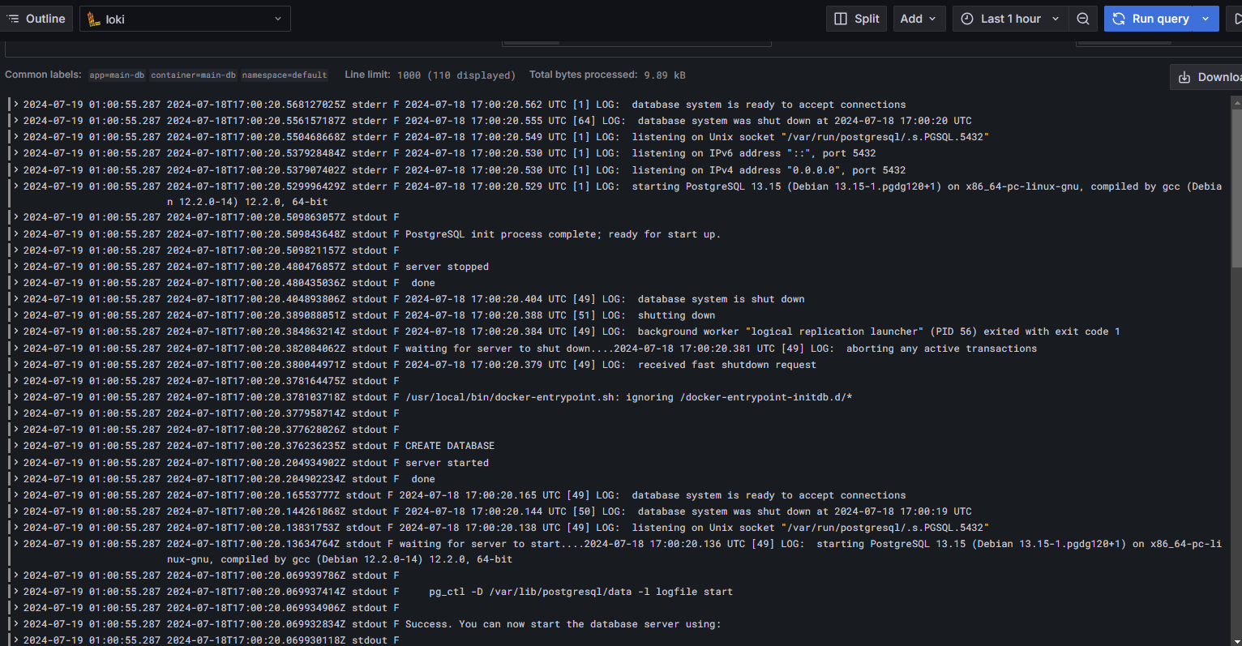

Slide 18
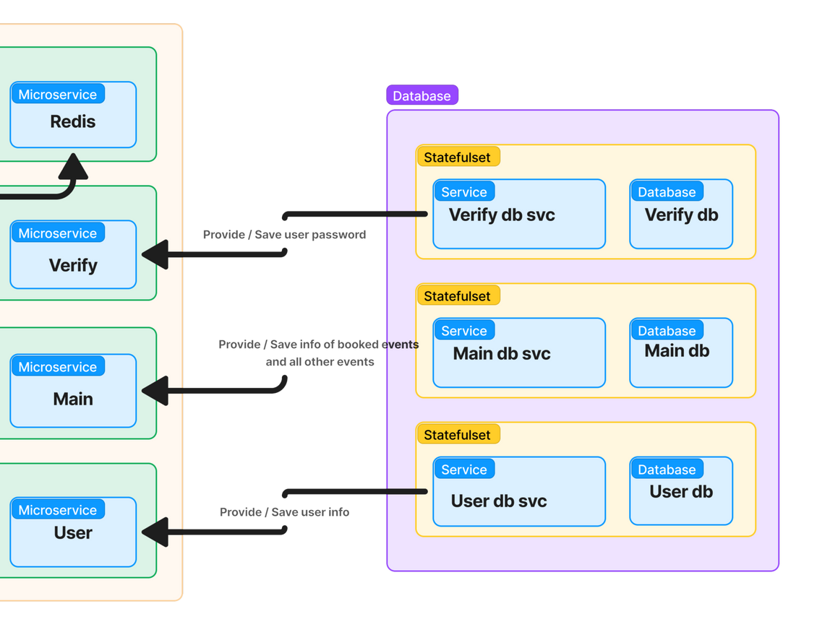
B. Custom Operator
Why do we need it?
Distributed databases:
--To decouple, each db has its own main purpose
--However, all require ‘User’ information
--There are primary and secondary databases

Slide 19



A dedicated opertor:
--Sidecar:create and read the trigger of Database
--Database: Trigger to detect changes
--SyncOperator: Synchronize the main db and the others

Slide 20
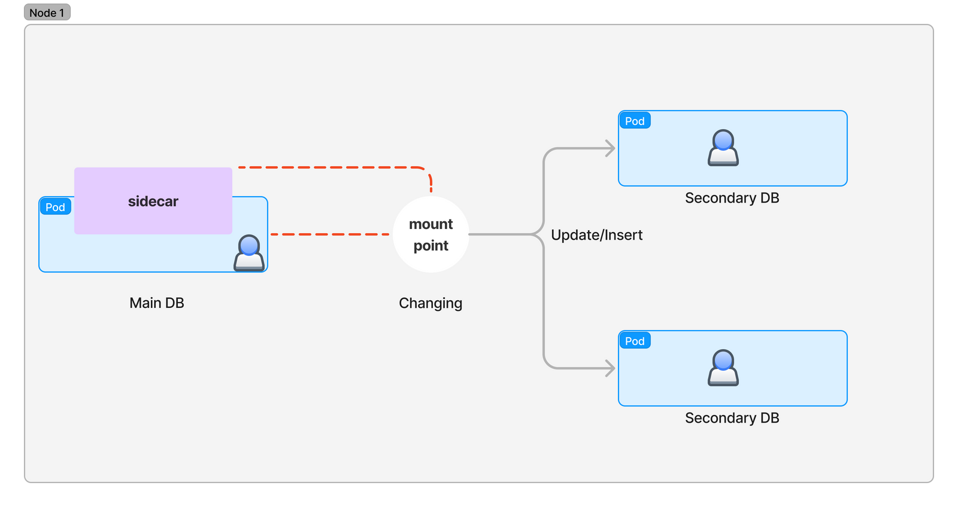

Data Synchronization
Data Consistency:
Ensures data consistency across multiple microservices. All relevant services get updated in real-time

Slide 21
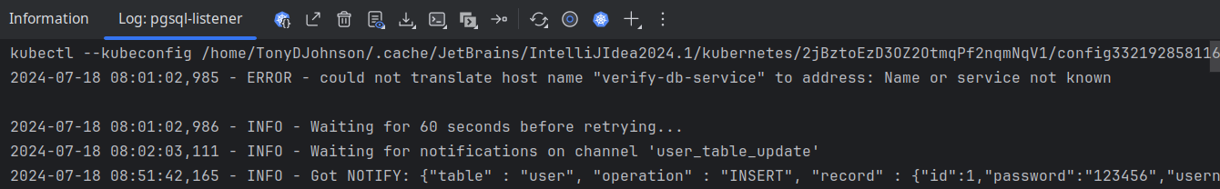
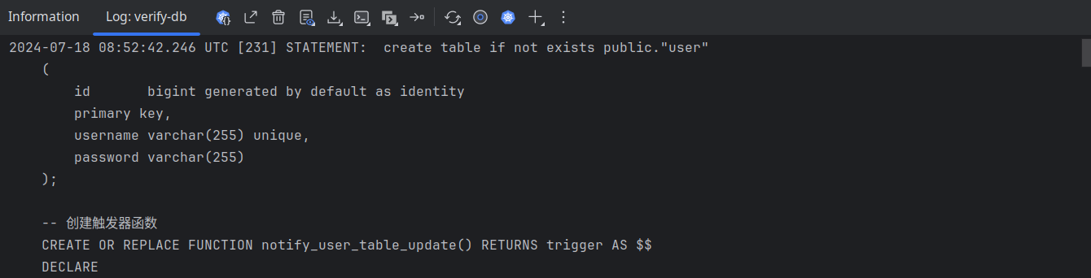
B. Data Synchronization
Sidecar:
A python written script to detect the trigger
Trigger:
Implemented by PostgreSQL trigger

Slide 22
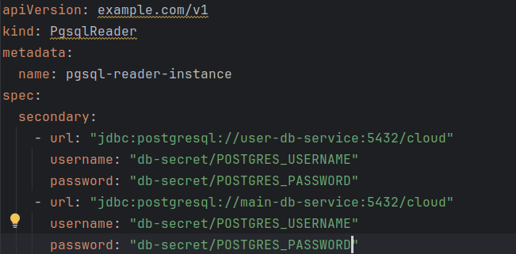
B. Data Synchronization : CRD
Combine the sidecar to the primary db ,
set the url of secondary db.

Slide 23

C: Zipkin:Why tracing
Distributed tracing system:
Latency Tracking
Visualizing Call Paths
Error Diagnosis

Slide 24
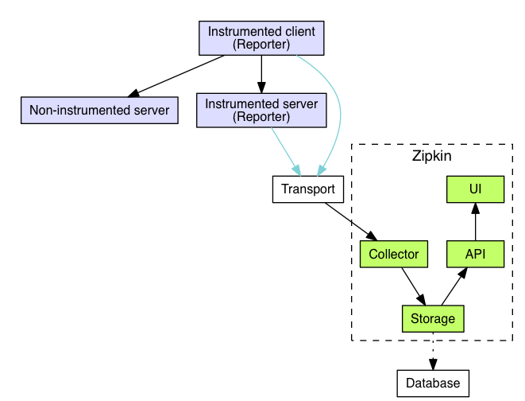
C: Zipkin:Workflow
Each microservice contains a reporter and actuator
Zipkin collect the workflow of requests

Slide 25
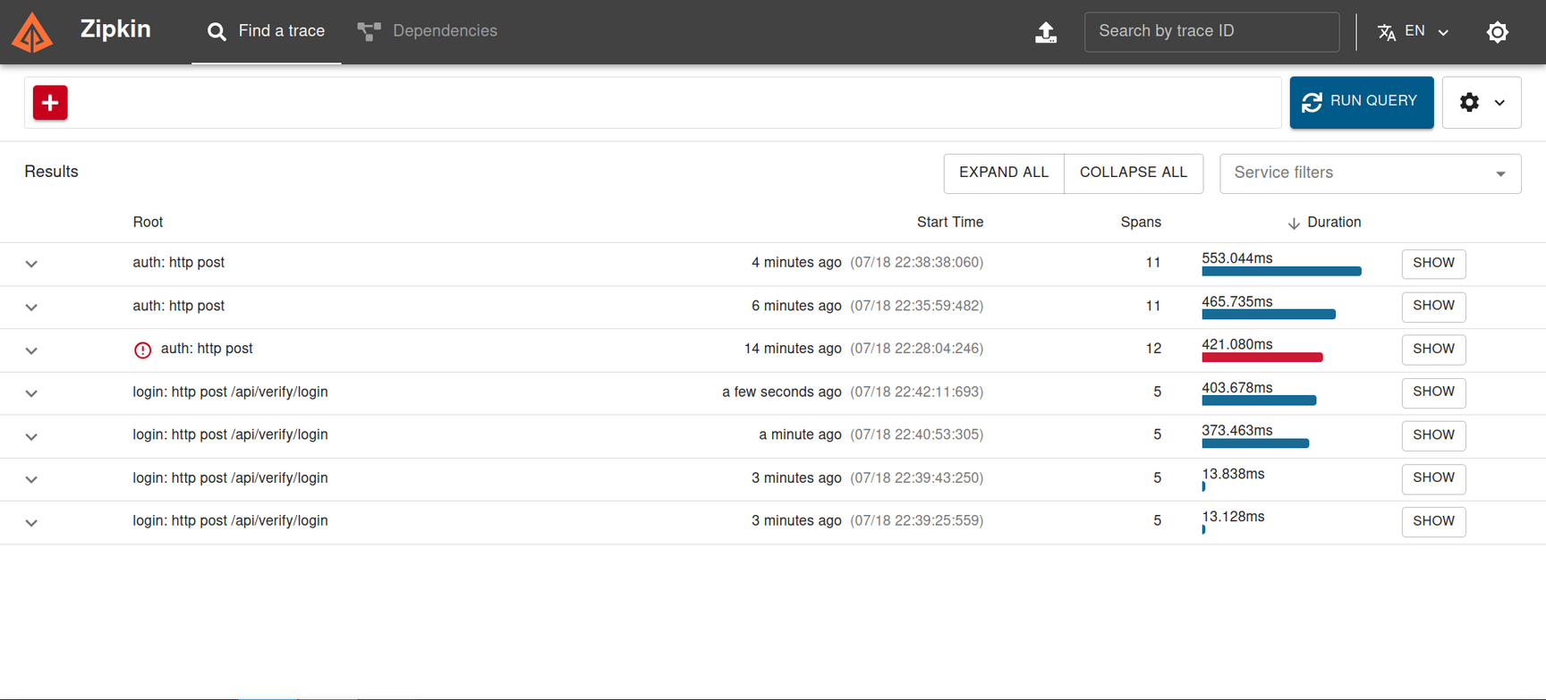
C: Zipkin

Slide 26
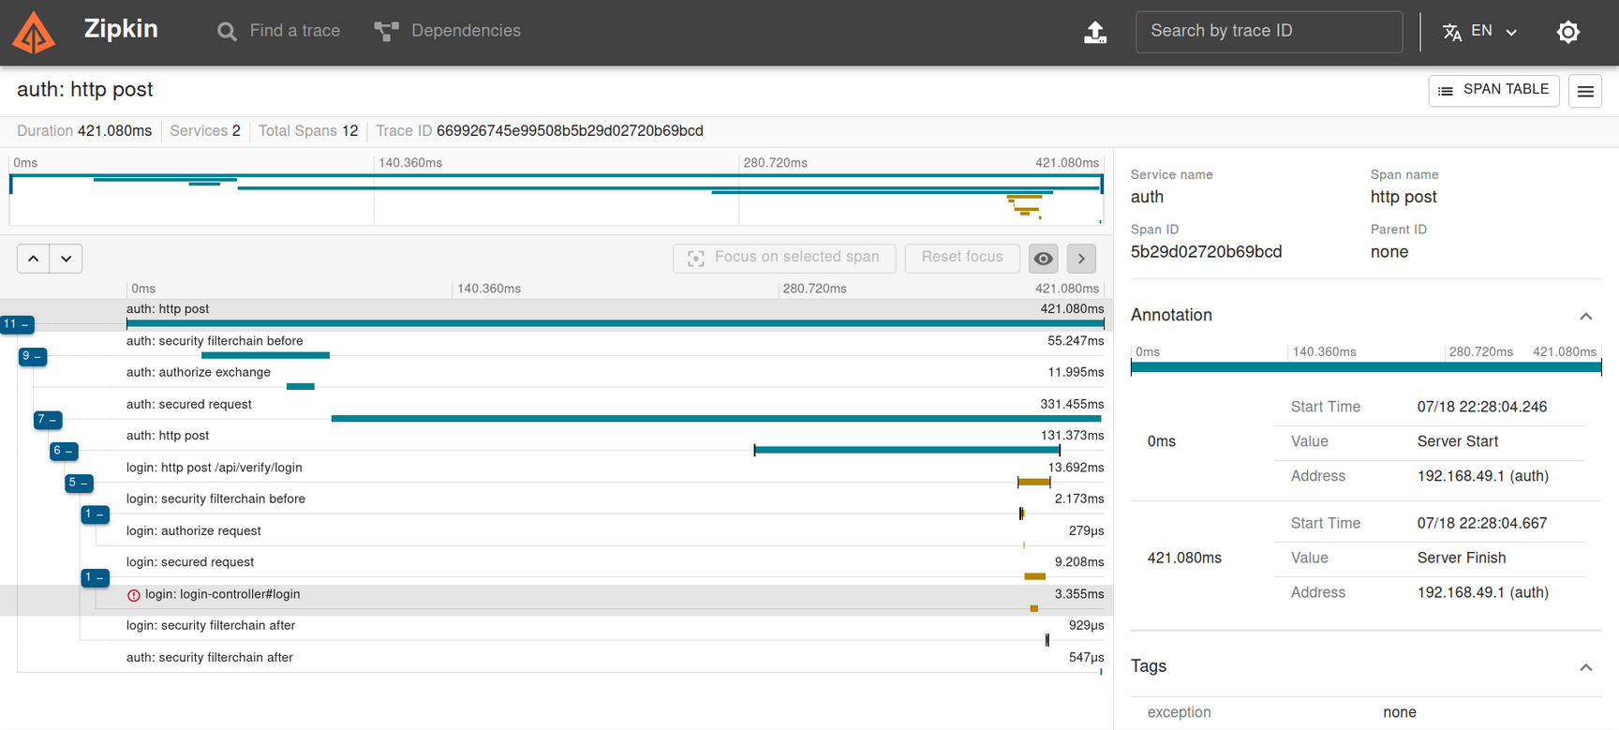
C: Zipkin

Slide 27

THANK YOU!

